Slide 1
Image processing
Lecturer: Hung- Nguyen Manh
HCMC University of Technology and Education

Slide 2
What is image processing??
Image and Video Processing: From Mars to Hollywood with a Stop at Hospital ( part_1- part_2)
Duke University
www

Slide 3
Course Objective
Students will understand how to process an image
They well understand the basic issues, the principle of designing and building a system of image processing.
Use of methods in image processing

Slide 4
What you want to learn?

Slide 5
Course logistics
In each week, we discuss several topics:
Ex: week 1
Images are everywhere
Human visual system
Image formation
Simple image operations
For each topic:
Remind previous topic/ knowledge
What we will discuss in the topic?
Detail of the topic
What next?

Slide 6
Grading policy
The overall course grades (letter-grades from 0 to 10) will be assigned based on required standard or overall class distribution. The weights of the assignments and the examinations are:
Two Midterm Exams: 40% (each one_20%).
Attendance: 10%
One comprehensive final exam or (project): 50%

Slide 7
Textbooks and other required materials
* Textbook:
[1] Nguyen Thanh Hai, Image Processing, VNU-HCM publisher, 2014 .
* Reference
William K. Pratt, Digital Image Processing, John Wiley & Sons, Inc., 2001.
Rafael C. Gonzalez, Richard E. Woods, Digital Image Processing, The Third Edition,Prentice Hall, 2008.
Rafael C. Gonzalez, Richard E. Woods, Digital Image Processing Using Matlab, Prentice Hall, 2004.
Kayvan N., Robert S., Biomedical Signal and Image Processing, Taylor and Francis Group, 2006.

Slide 8
Content
Images are everywhere
Human visual system
Image formation
Simple image operations

Slide 9
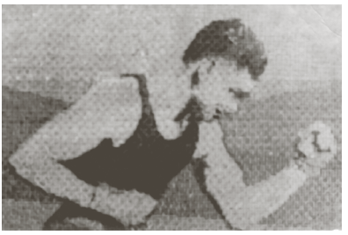
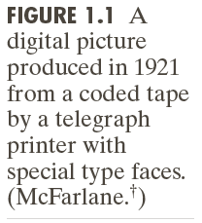
Images are everywhere
Notes:
Lịch sử của ảnh : ảnh đầu tiên

Slide 10
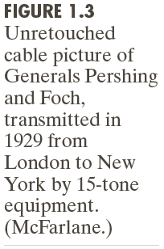
Images are everywhere
Notes:
ứng dụng đầu tiên của ảnh: báo chí

Slide 11
Images are everywhere

Slide 12
Images are everywhere
Why we can see??

Slide 13
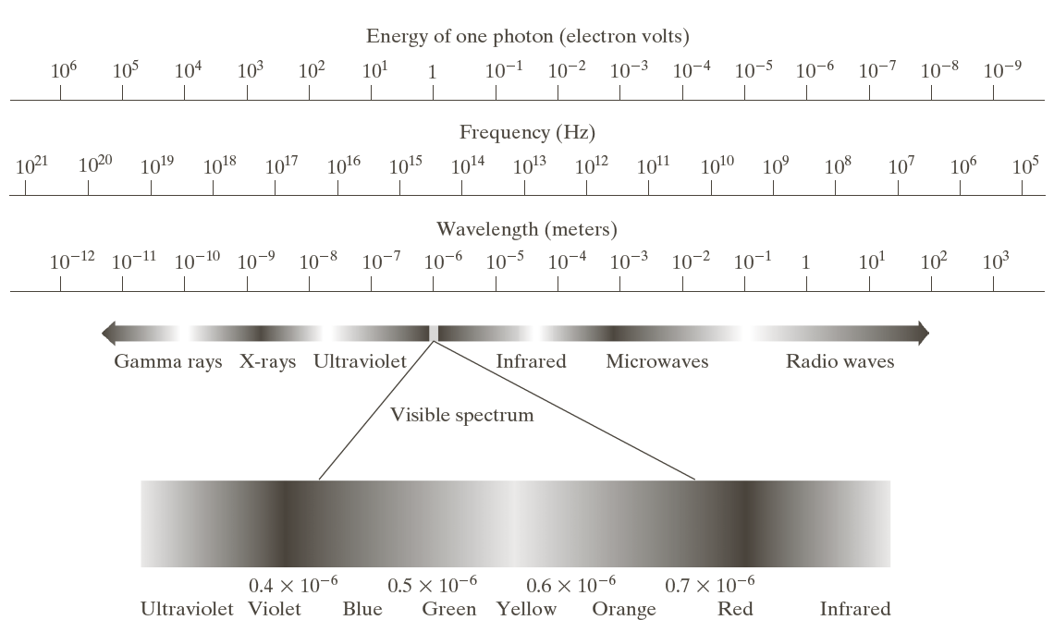
Images are everywhere
What we can see?

Slide 14
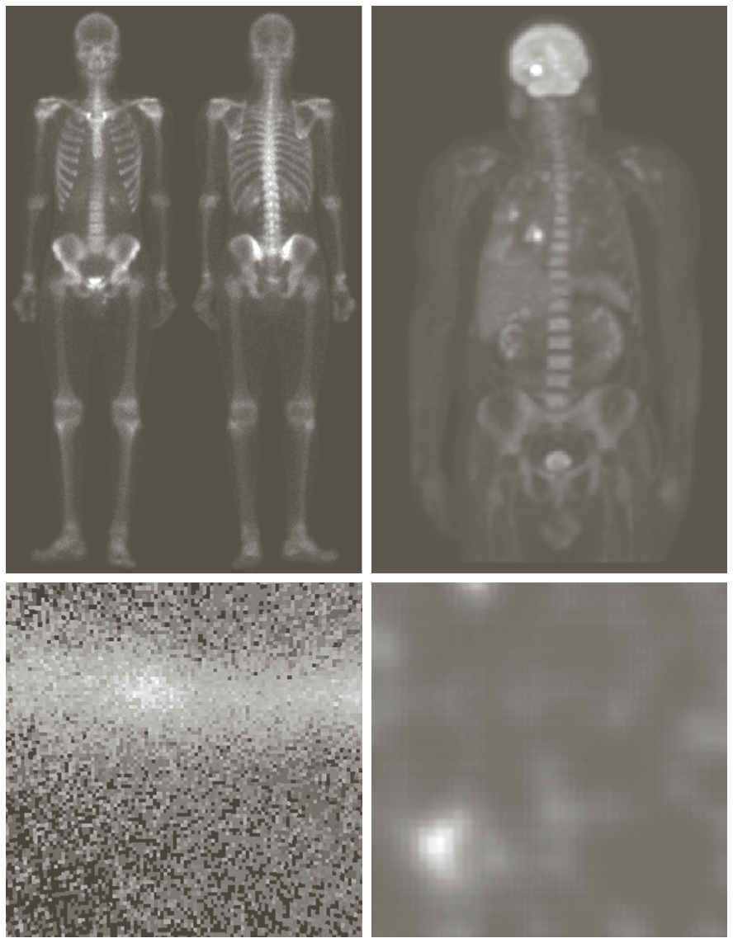
Images are everywhere

Slide 15
Images are everywhere
Notes:
Các loại ảnh khác nhau

Slide 16
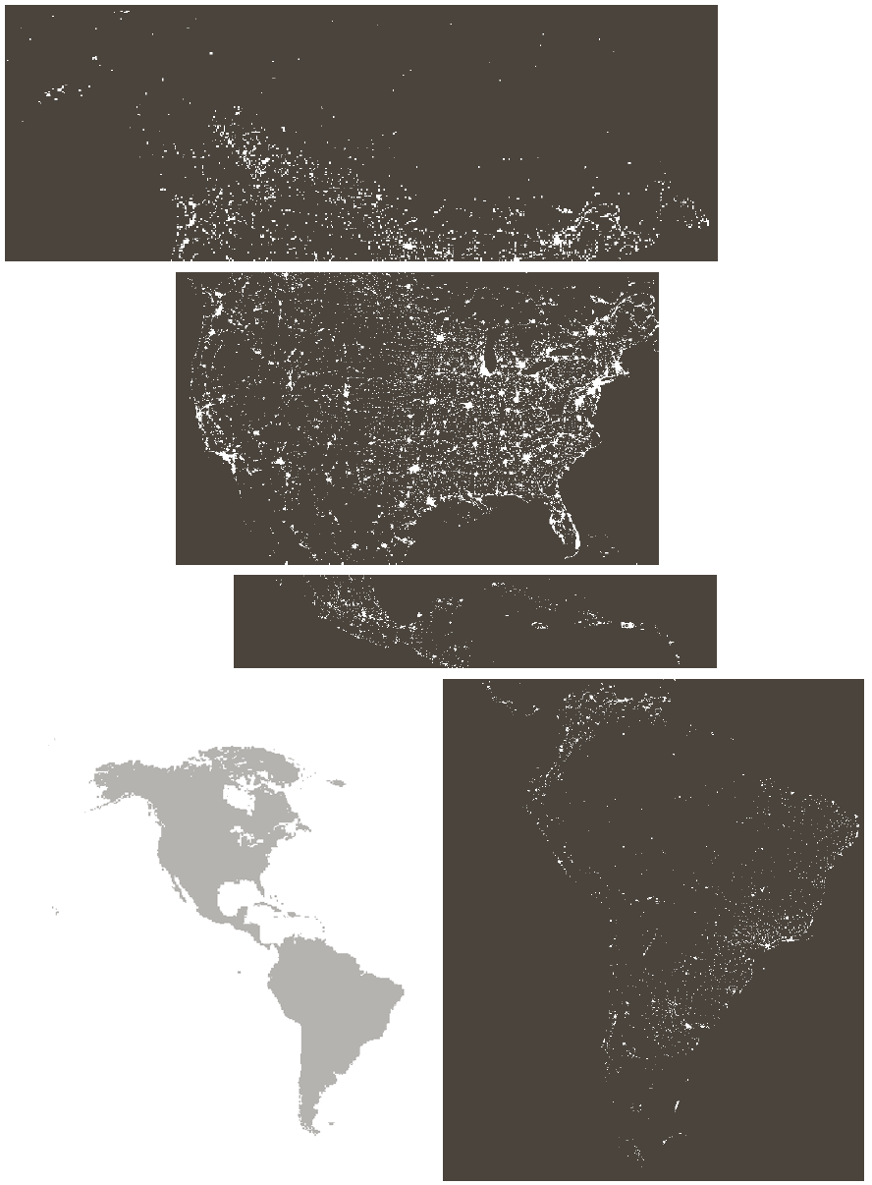
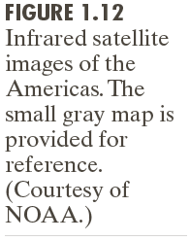
Images are everywhere

Slide 17
Images are everywhere

Slide 18
Images are everywhere
Notes:
Một số ứng dụng của ảnh

Slide 19
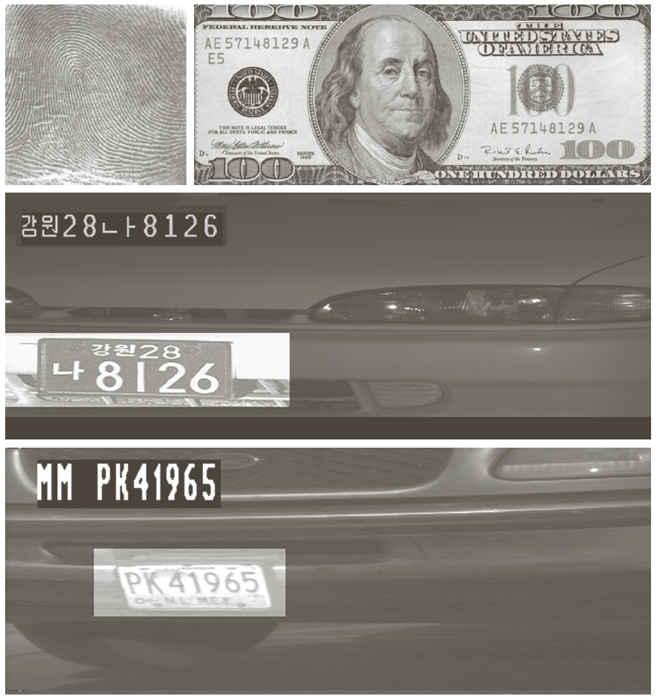
Images are everywhere

Slide 20
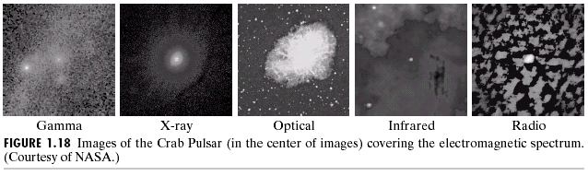
Images are everywhere

Slide 21
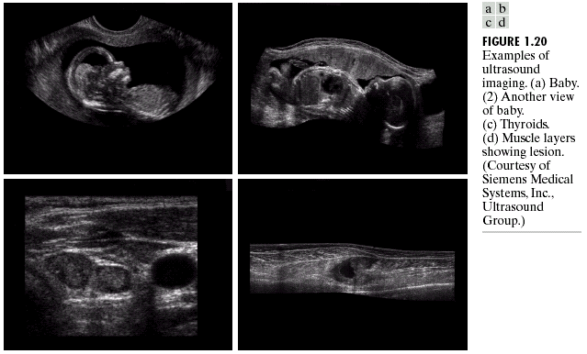
Images are everywhere

Slide 22
Human visual system

Slide 23
Human visual system

Slide 24
Human visual system

Slide 25
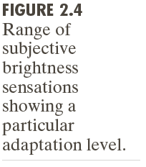
Human visual system

Slide 26
Human visual system

Slide 27
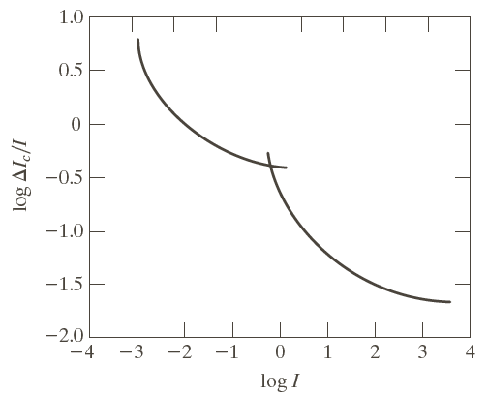
Human visual system

Slide 28
Human visual system

Slide 29
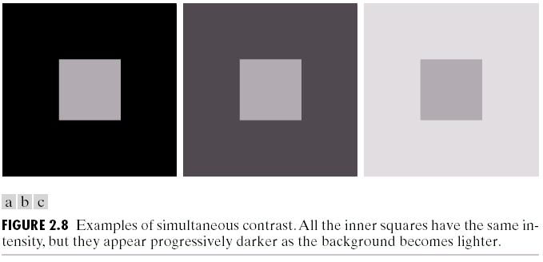
Human visual system

Slide 30
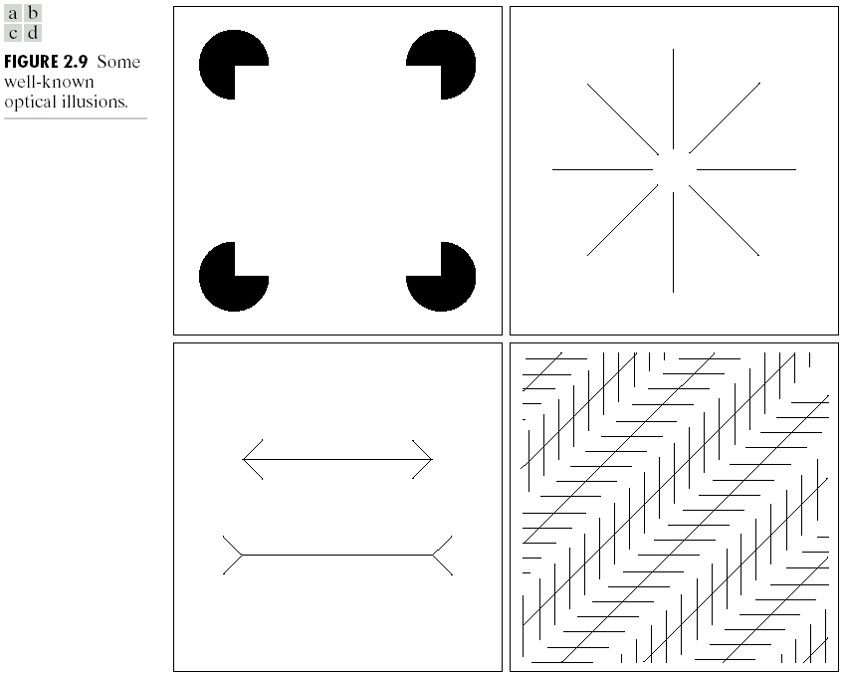
Human visual system

Slide 31
Image formation

Slide 32

Image formation

Slide 33
Image formation

Slide 34
Image formation

Slide 35
Image formation

Slide 36
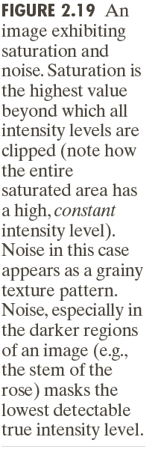
Image formation

Slide 37
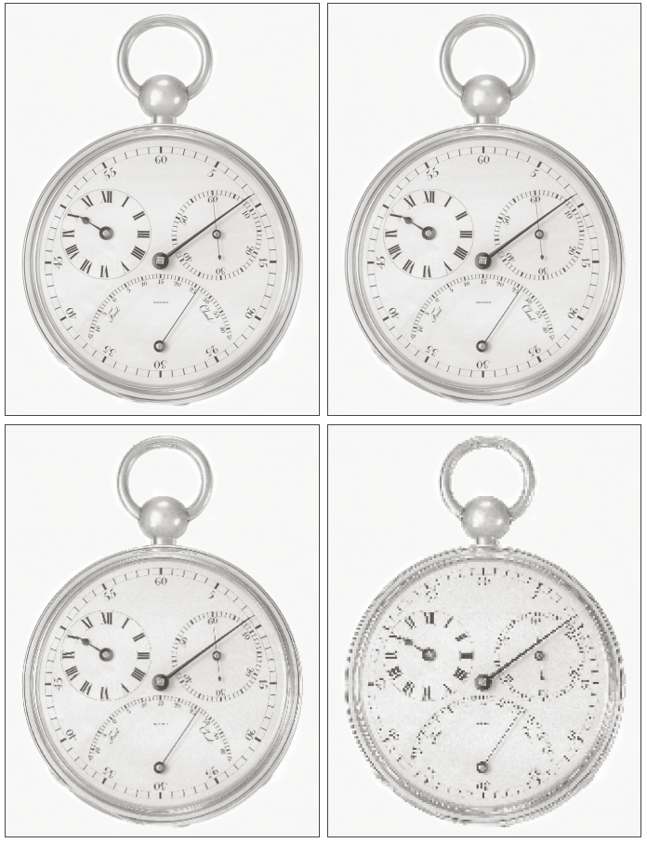
Image formation

Slide 38
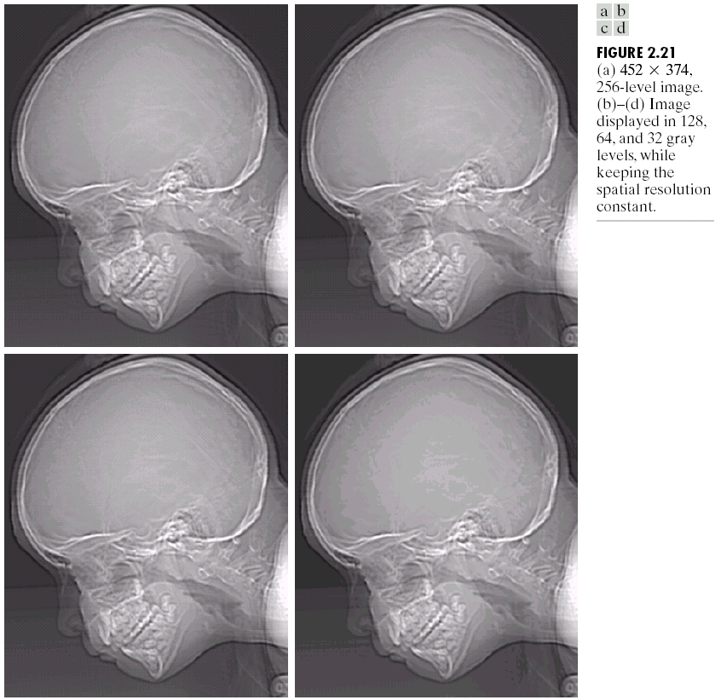
Image formation

Slide 39
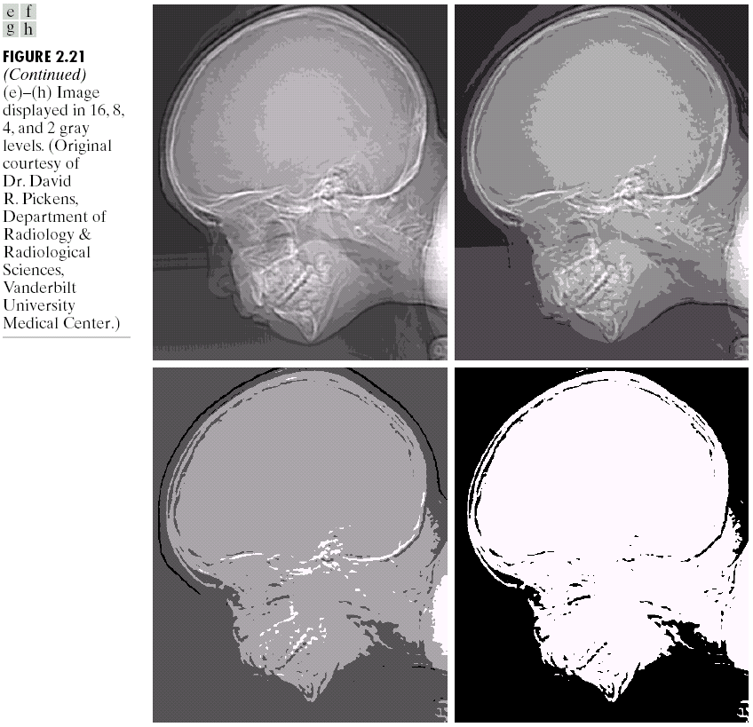
Image formation

Slide 40
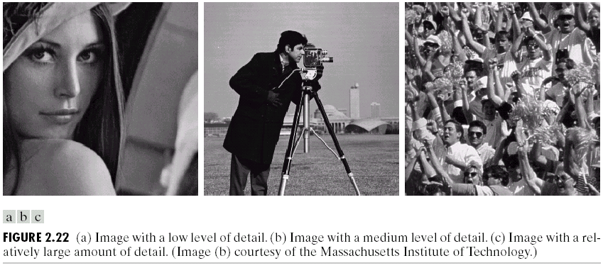
Image formation
Experiment
The gray level resolution was varied in all the images, and the audience was asked to rate these three images subjectively. After the rating, a graph was drawn according to the results.

Slide 41
Image formation

Slide 42
Simple image operations

Slide 43
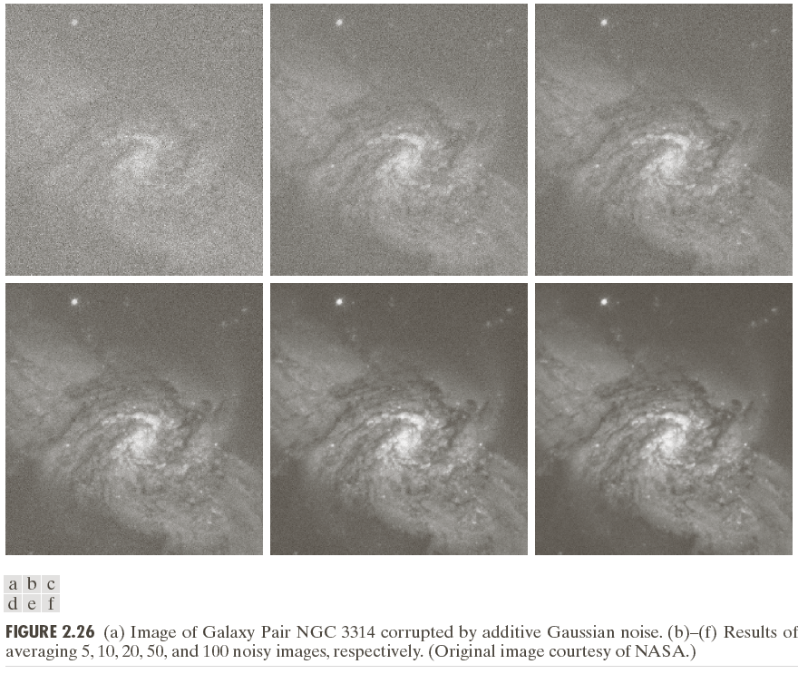
Simple image operations

Slide 44
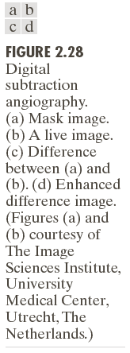
Simple image operations

Slide 45
Simple image operations

Slide 46
Simple image operations

Slide 47
Simple image operations

Slide 48
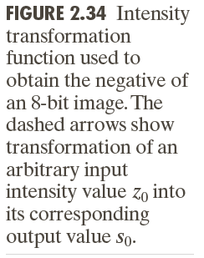
Simple image operations

Slide 49
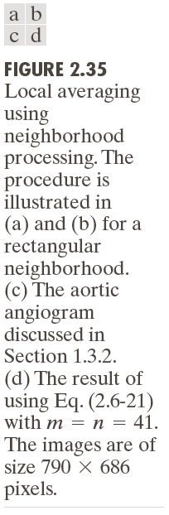
Simple image operations

Slide 50
Simple image operations

Slide 51
Simple image operations

Slide 52
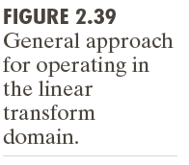
Simple image operations

Slide 53
Simple image operations

Slide 54
Simple image operations

